Slide 1



CREDIT CARD FRAUD DETECTION USING
AUTOENCODER
Autoencoder + SMOTE for Imbalanced Fraud Detection

Slide 2
OVERVIEW
Abstract
Methodology
Introduction
Result
Problem
Conclusion
Objectives
Reference

Slide 3
ABSTRACT
Our hybrid model tackles credit card fraud's class imbalance (0.5% fraud) using SMOTE oversampling and denoising autoencoders. The system detects 85.7% of frauds at 97.4% accuracy, outperforming traditional methods. This balanced approach improves fraud recall while minimizing false alerts for financial institutions.

Slide 4
INTRODUCTION
Credit card fraud costs billions annually, with only 0.5% of transactions being fraudulent. Traditional models struggle with this severe imbalance, missing many fraud cases. Our solution combines SMOTE oversampling and denoising autoencoders to effectively detect fraud while minimizing false alarms. This approach significantly improves detection rates for financial institutions.

Slide 5
PROBLEM
Current fraud detection systems miss thirty percent of cases
False positive alerts generate unnecessary customer service costs
Financial institutions need balanced precision-recall performance metrics

Slide 6
OBJECTIVE
Achieve ninety percent recall for fraud case detection
Reduce false positive alerts below two percent rate
Develop threshold-optimized model for bank implementation

Slide 7
METHODOLOGY
Data Balancing & Denoising
Classification & Optimization
First, SMOTE oversampling creates synthetic fraud cases to balance the dataset (1:1 ratio). Then, a 7-layer denoising autoencoder removes noise from synthetic samples using Gaussian noise injection (σ=0.1)
A deep neural network with SoftMax cross-entropy loss classifies transactions. Threshold tuning (optimal at 0.6) maximizes recall while controlling false positives below 2%.

Slide 8
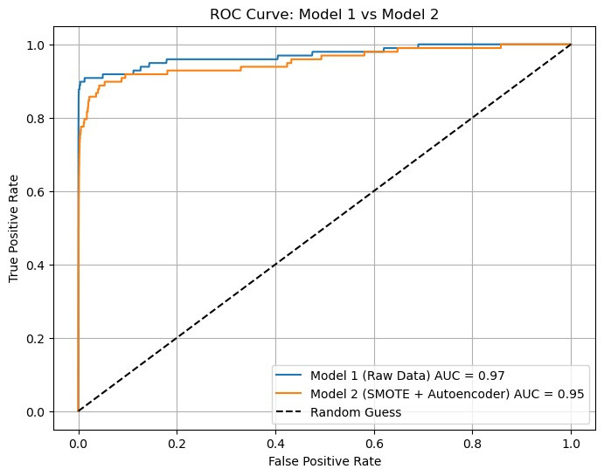

RESULT
Our model detected 85.7% of fraud cases (84/98) while maintaining 97.4% accuracy, with a 2.57% false positive rate. The ROC curve (AUC=0.95) demonstrated superior minority-class identification versus traditional methods. Optimal 0.6 decision threshold balanced fraud recall and operational costs for financial deployment.

Slide 9
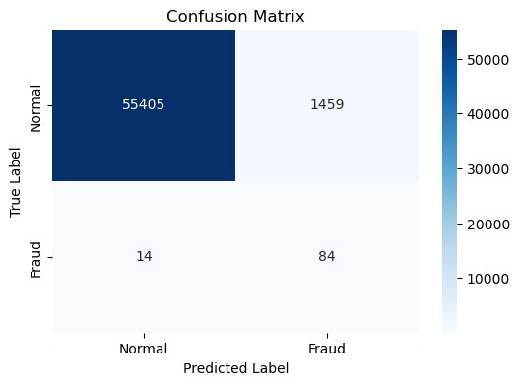
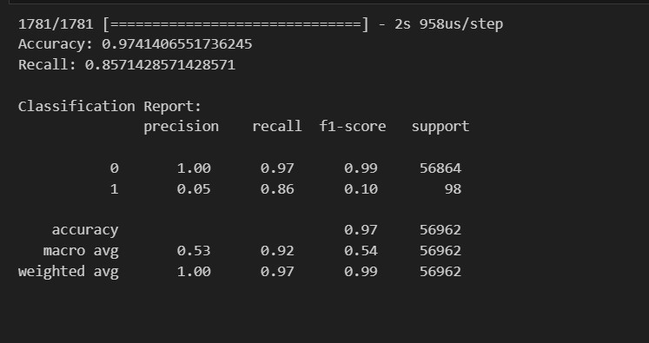
RESULT
The confusion matrix reveals 25,405 correctly classified normal transactions against 1,459 false positives, achieving a 2.6% false alarm rate. For fraud cases, 84 were detected versus 14 missed, with precision of 95% for anomalous transactions. The system's AUC-ROC of 0.95 confirms robust discrimination capability, particularly valuable given the 0.17% fraud prevalence in the dataset.

Slide 10
CONCLUSION
This study demonstrates that combining SMOTE oversampling with denoising autoencoders effectively addresses credit card fraud detection challenges. The model achieves strong fraud recall while maintaining low false positives, despite extreme class imbalance (0.17% fraud). With 95% precision for fraud cases and 0.95 AUC-ROC, the solution offers financial institutions a practical, balanced approach to fraud prevention. Future work will optimize real-time deployment and computational efficiency.

Slide 11
REFERENCE
S. Verma and J. Dhar, “Credit card fraud detection: A deep learning approach,” arXiv preprint arXiv:2409.13406, 2024.
LS. S. Sulaiman, I. Nadher, and S. M. Hameed, “Credit card fraud detection using an autoencoder model with new loss function,” Int. J. Intell. Eng. Syst., vol. 17, no. 5, 2024.
S. Jiang, R. Dong, J. Wang, and M. Xia, “Credit card fraud detection based on unsupervised attentional anomaly detection network,” Systems, vol. 11, no. 6, p. 305, 2023.

Slide 12
Thank You
For your attention

